Slide 1


Slide 2
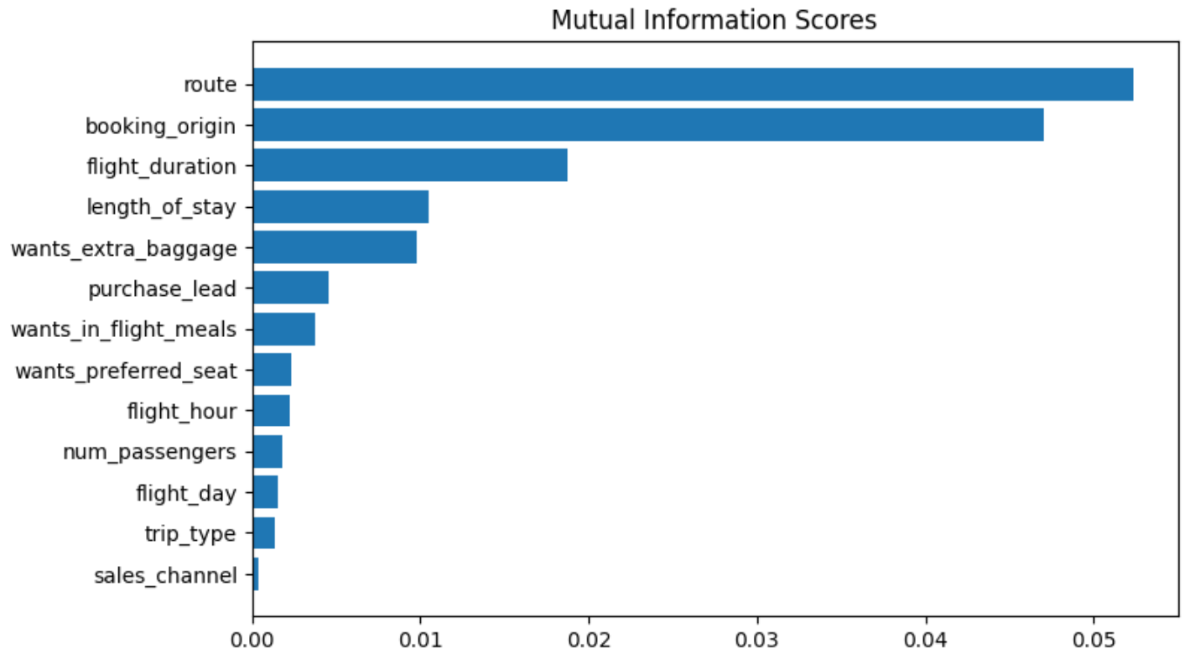

Slide 3
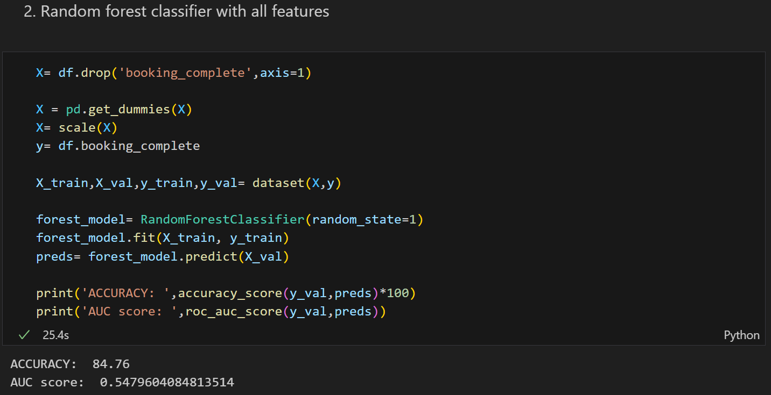
Model with the highest Accuracy and AUC Score on Cross Validation Data

Slide 4

Test Data Accuracy and AUC Score based on the most efficient model (Slide-3)

